Slide 1
Motivation
Oxford University
Software Engineering Programme
April 2021

Slide 2
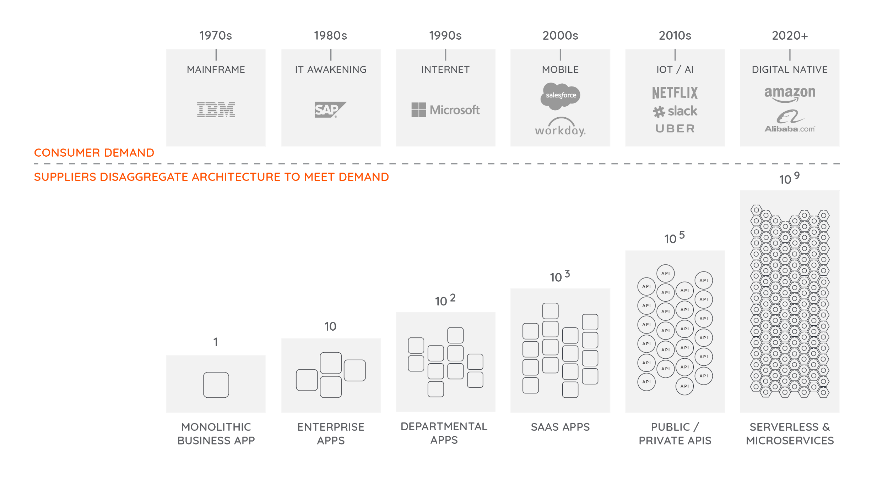
Notes:
**Ballerina slides redone for WSO2.**
We have seen crazy customer demand cause architectures to disaggregate - to turn into elemental building blocks. When software is broken into individual components, it is easier to build them with an independent team and for that software to elastically be scaled - all without impacting the other building blocks that make up the system.
** Consider finding a way to incorporate Conway’s law .. or perhaps use that when I introduce the waterfall concepts around the CoE below.

Slide 3
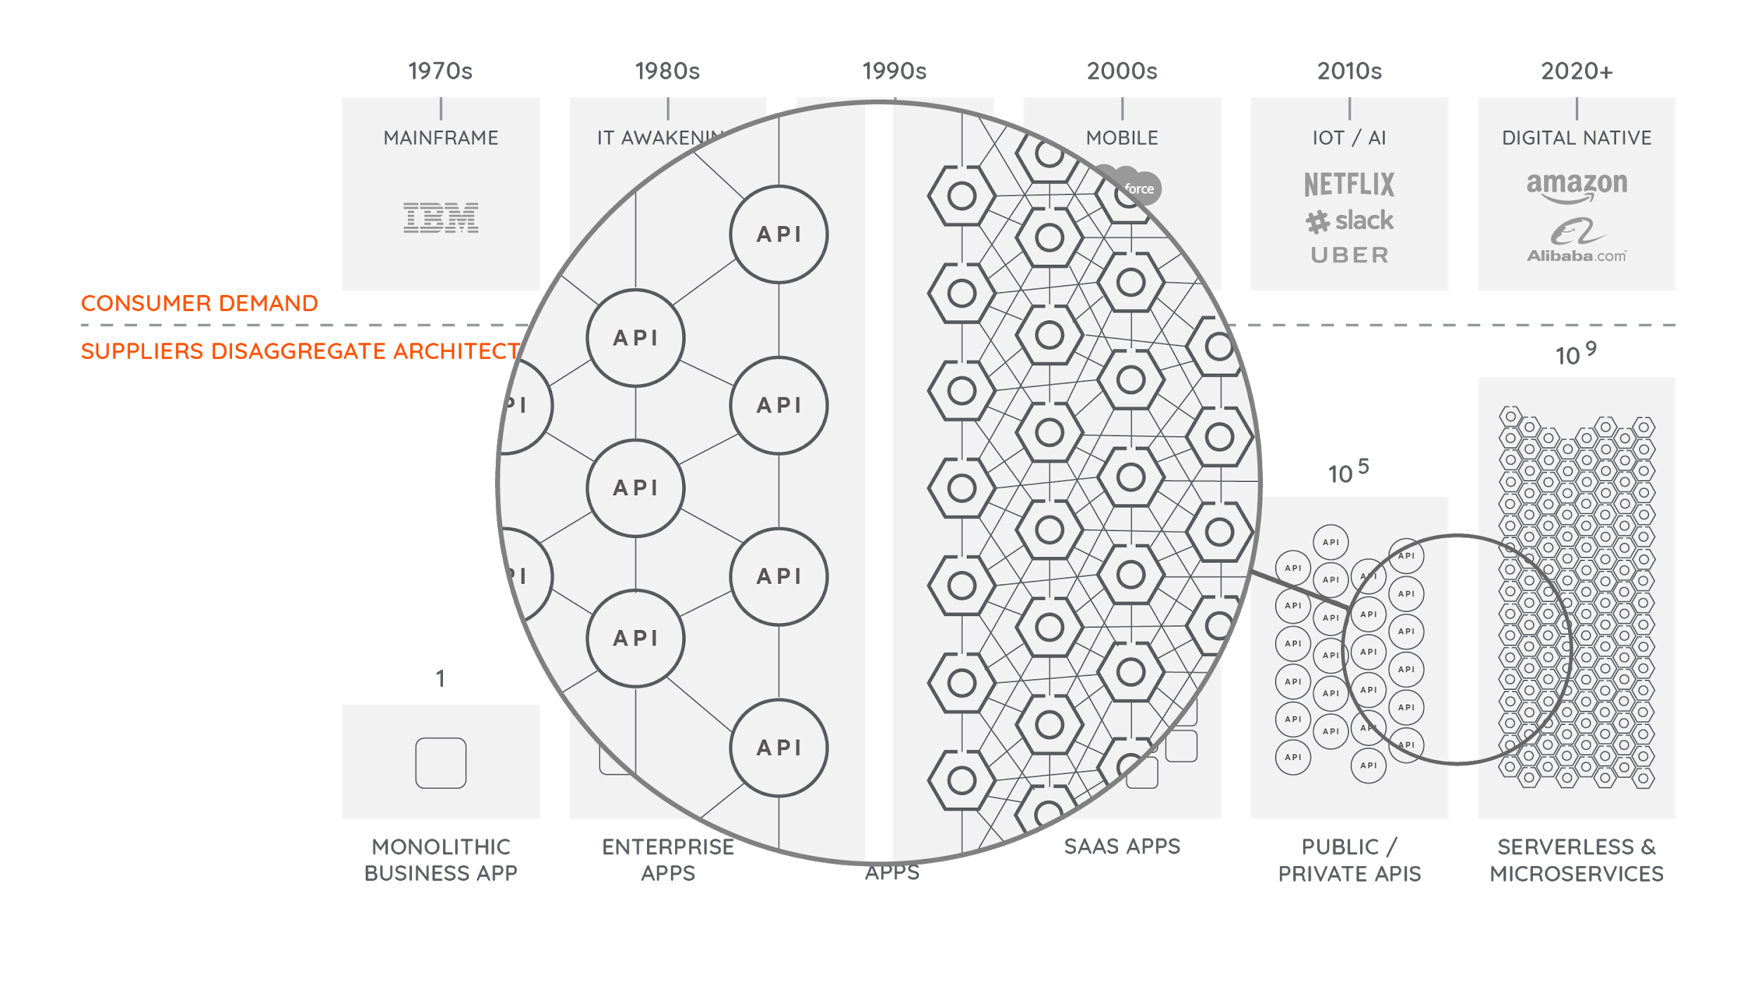

Slide 4
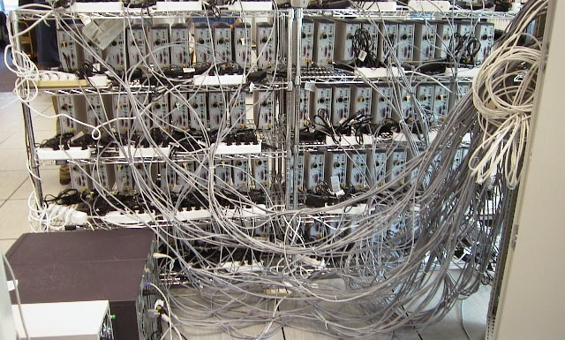
Distributed Computing

Slide 5
Why is Distributed Computing important?
Scale
Evolution
Integration
Cross-boundary
Resilience

Slide 6
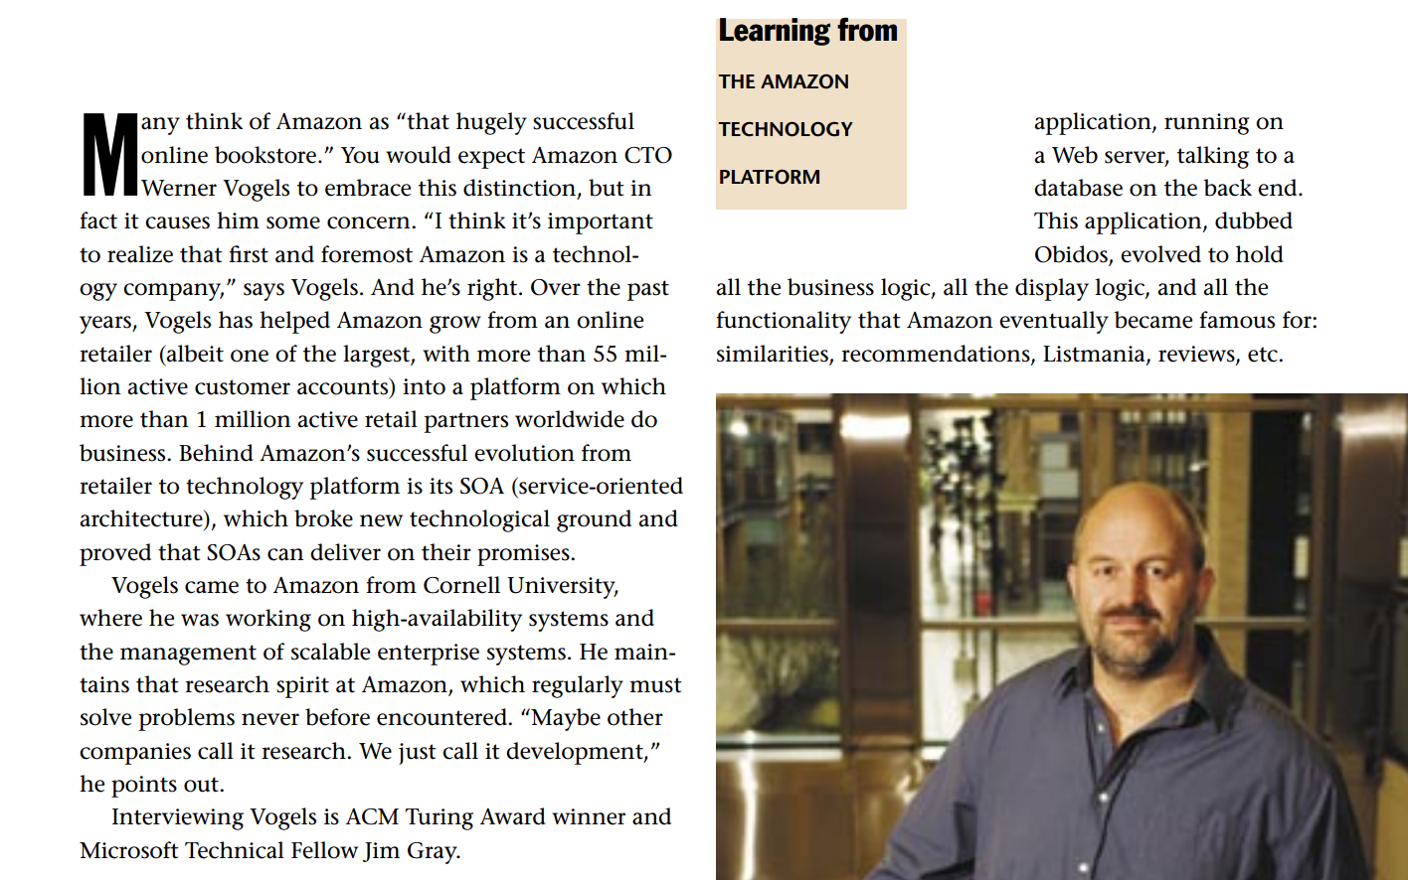
Source: Interview with Werner Vogels, ACM Queue
https://queue.acm.org/detail.cfm?id=1142065

Slide 7
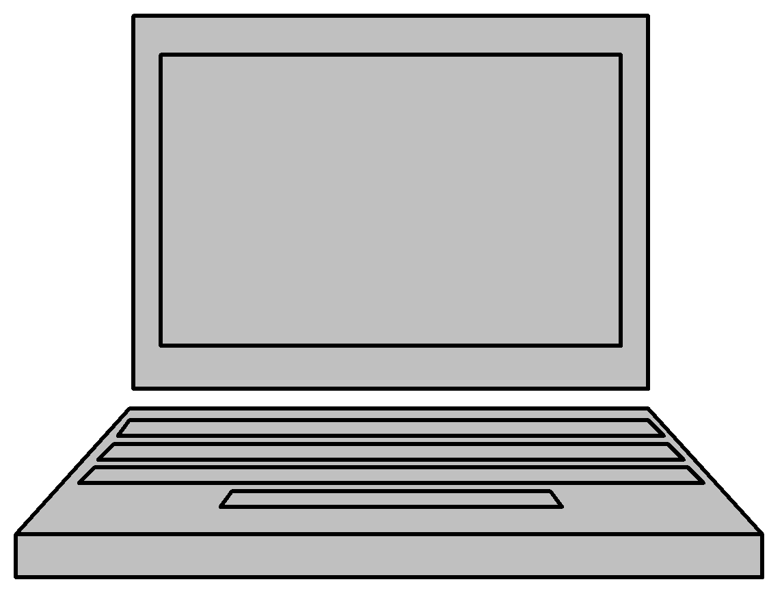
“Obidos”
Web App
Database
Web App
Web App
Single application

Slide 8

But it was Successful!

Slide 9

Internet Scale Up
Web App
Database
Web App
Web App
Single application

Slide 10
… to bursting point
Database
Web App
Web App
Web App
Web App
Web App
Web App
Web App
Web App
Web App
Web App
Web App
Web App
Web App
Web App
Web App
Single application

Slide 11
Problems
Too many complex pieces of software in a single system
No evolution possible
Need to scale independently
Parts sharing resources with other unknown code paths
No isolation
No clear ownership

Slide 12
Database scaling
Databases a shared resource
Hard to scale-out
Front-end and backend shared by
Too many teams
Too many processes

Slide 13
A new model
In 2001/2 decided on a new approach
SOA based – even before the term was in common usage
Encapsulating the data with the business logic that operates on the data
Only access through a published service interface
No direct database access is allowed from outside the service
No data sharing among the services.

Slide 14
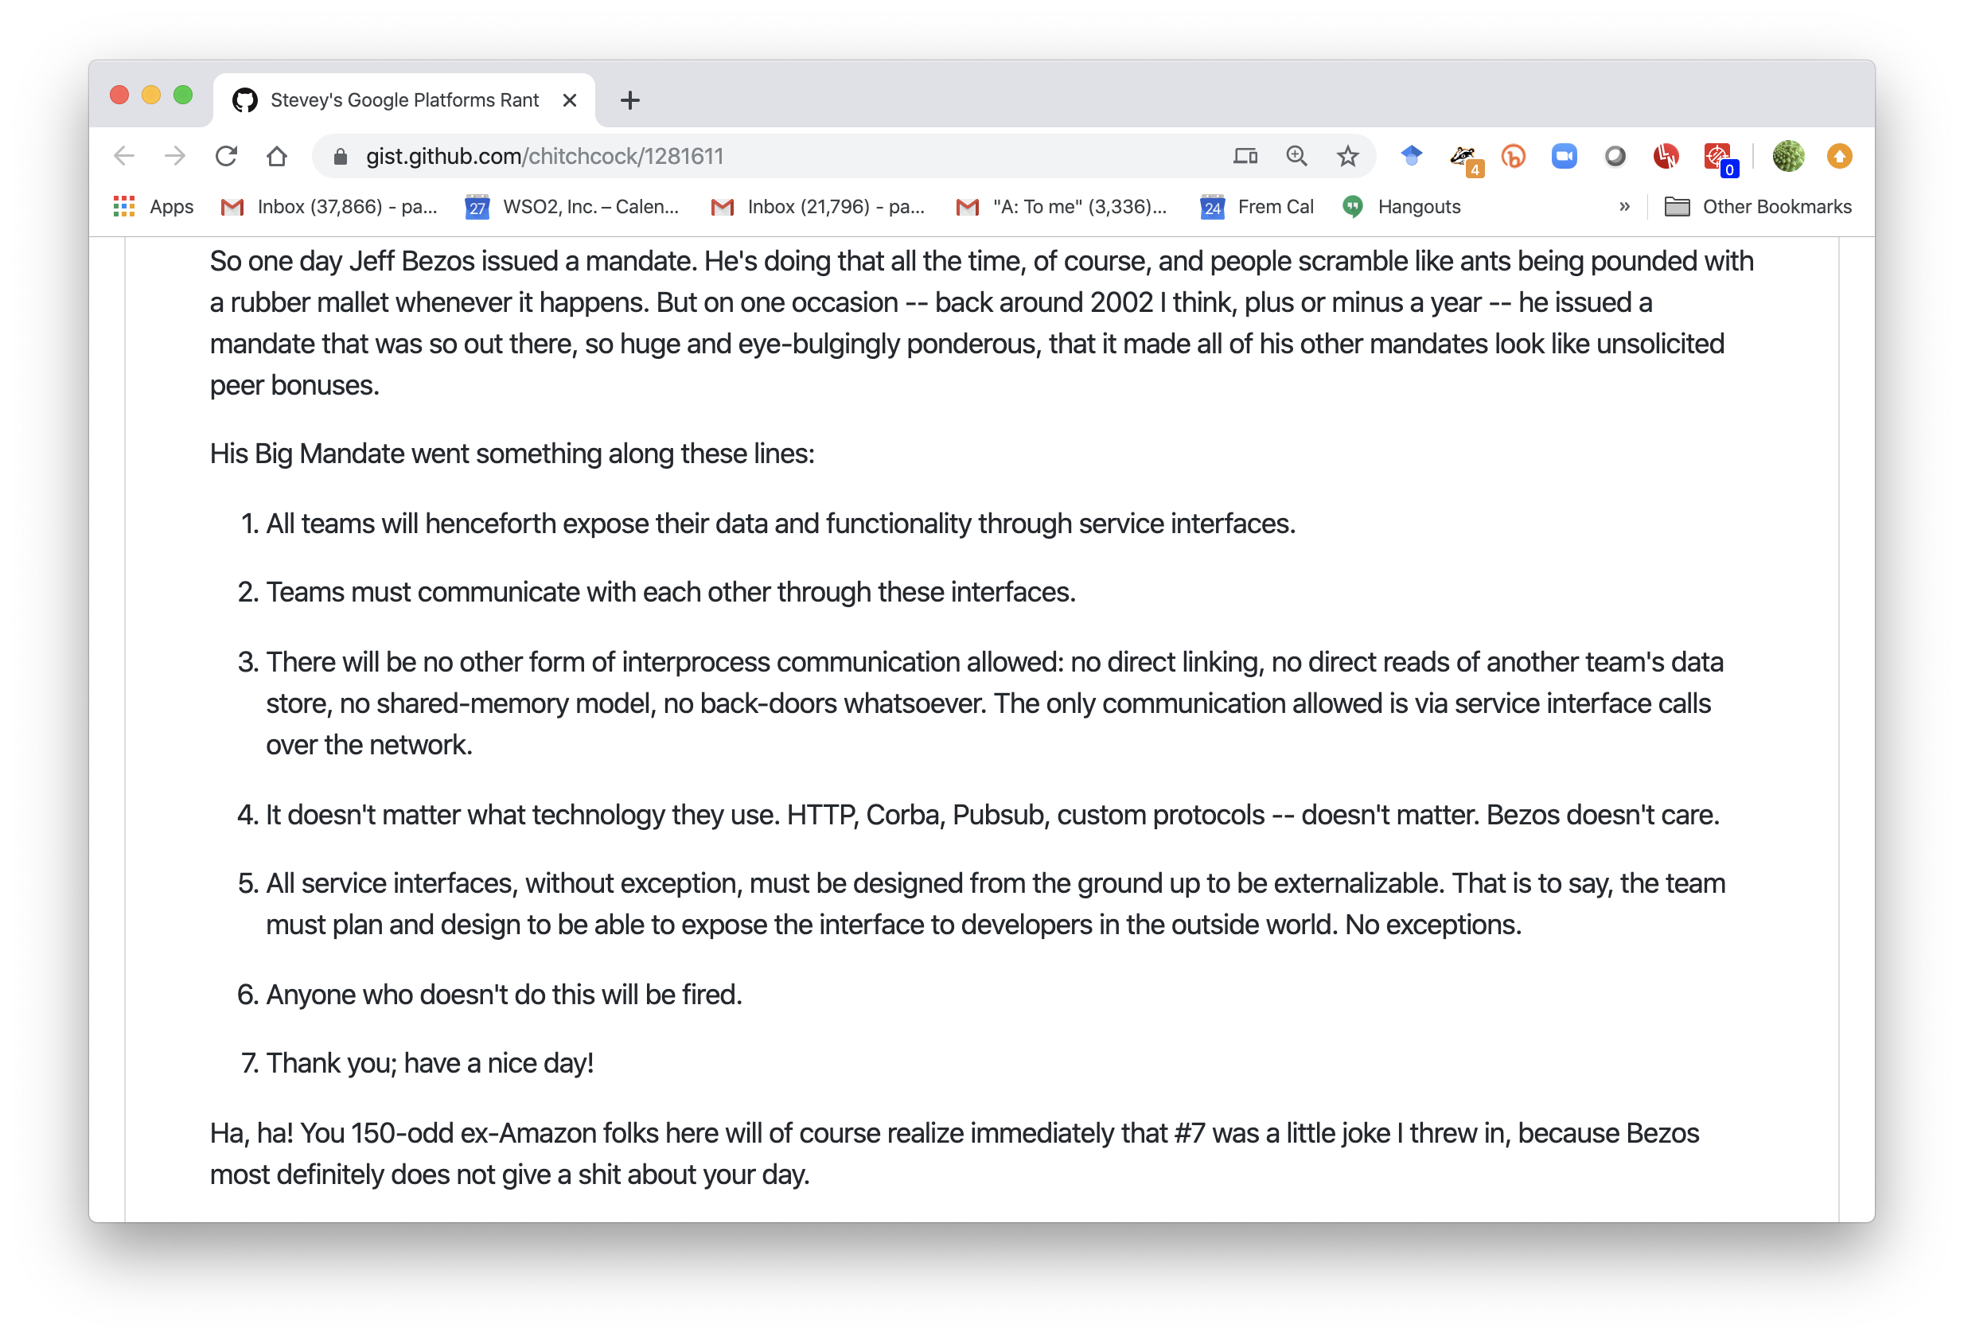

Slide 15
Growth
Amazon services in the hundreds
A typical visit to the homepage may include calls to 100 services
Caching reduces the actual network traffic
Fully distributed, decentralized
The web servers are just one client into the service fabric

Slide 16
Matched by business growth
Amazon is supporting many new businesses
Books, CDs, Electronics, Toys, Tools and Hardware,…
Plus millions of independent retailers sharing the Amazon platform

Slide 17
Lessons learnt
Isolation
Service Orientation promotes ownership and control
Scalability
By preventing direct database access, can scale the services without affecting clients
Need a common service-access mechanism
Aggregation
Routing
Tracking

Slide 18
Organization
“Each service has a team associated with it, and that team is completely responsible for the service—from scoping out the functionality, to architecting it, to building it, and operating it… You build it, you run it” Werner Vogels, CTO, Amazon
Promotes Customer Focus and Innovation
Gives developers direct access to customers
And experience of how their code performs

Slide 19
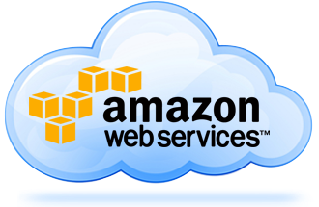

Slide 20
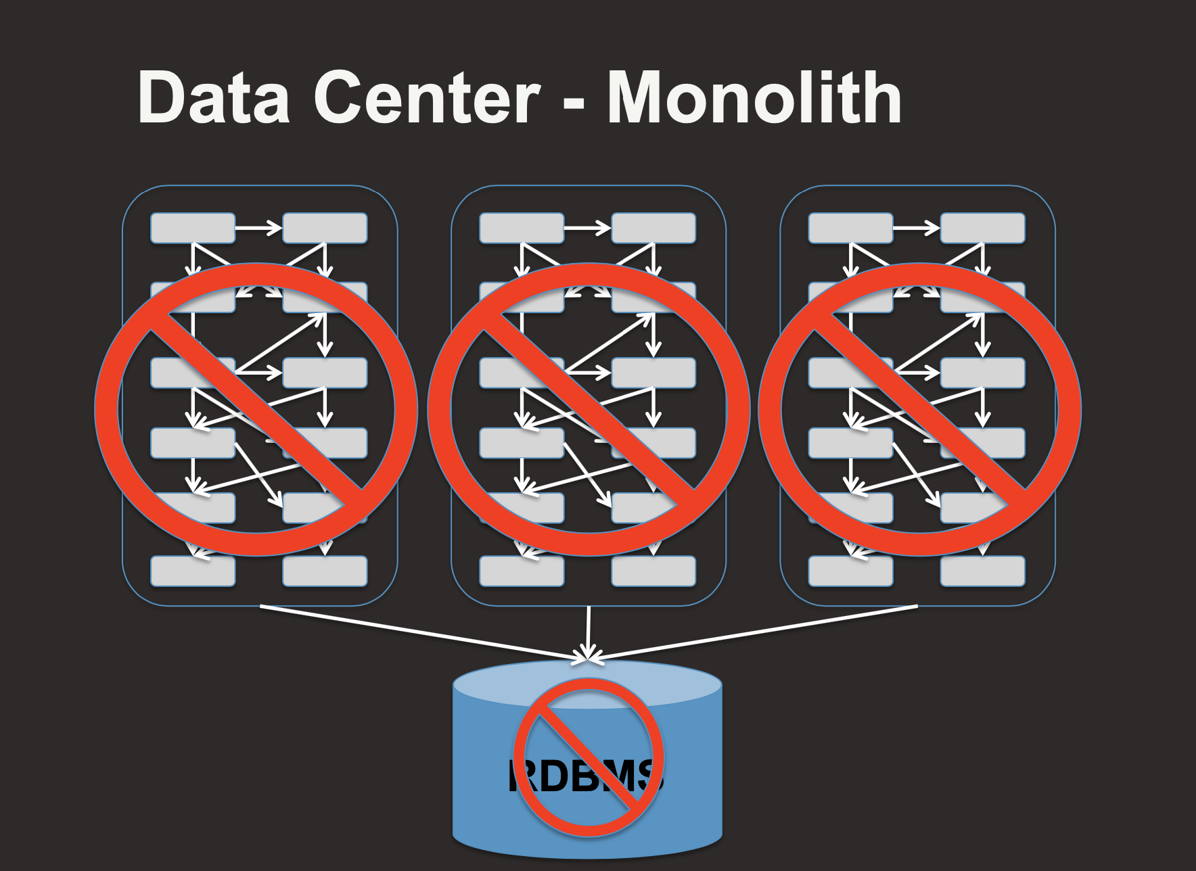
Netflix too….
https://www.slideshare.net/RuslanMeshenberg

Slide 21
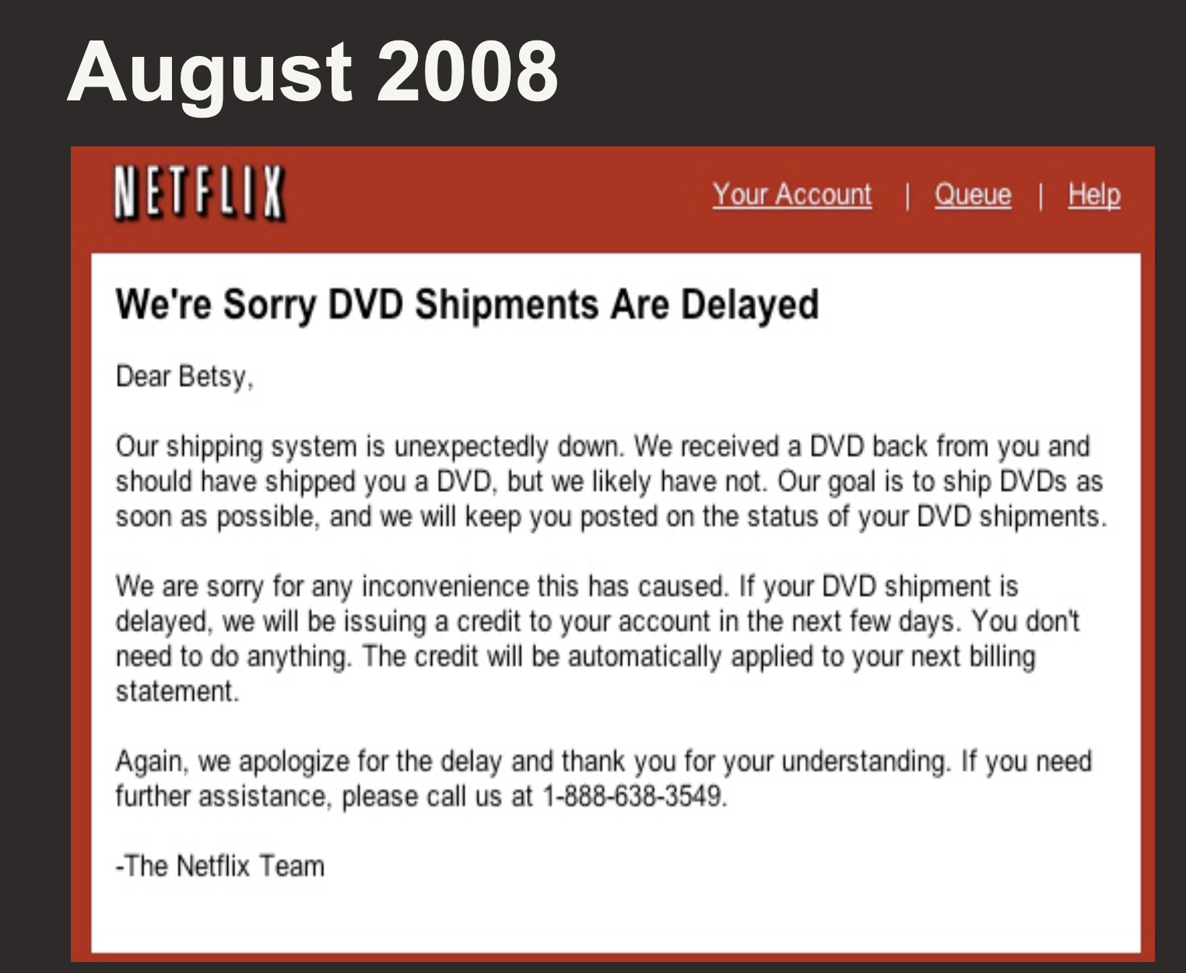

Slide 22

Service
http://www.flickr.com/photos/yjv/

Slide 23

Tightly coupled
Tightly coupled systems have significant problems:
Errors, delays and downtime spread through the system
The resilience of the whole system is based on the weakest part
Cost of upgrading or migrating spreads
Hard to evaluate the useful parts from the dead weight

Slide 24
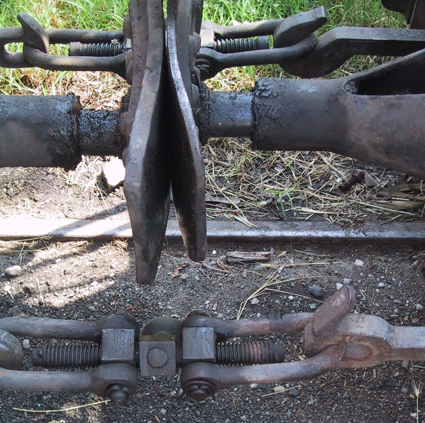
Loose coupling

Slide 25
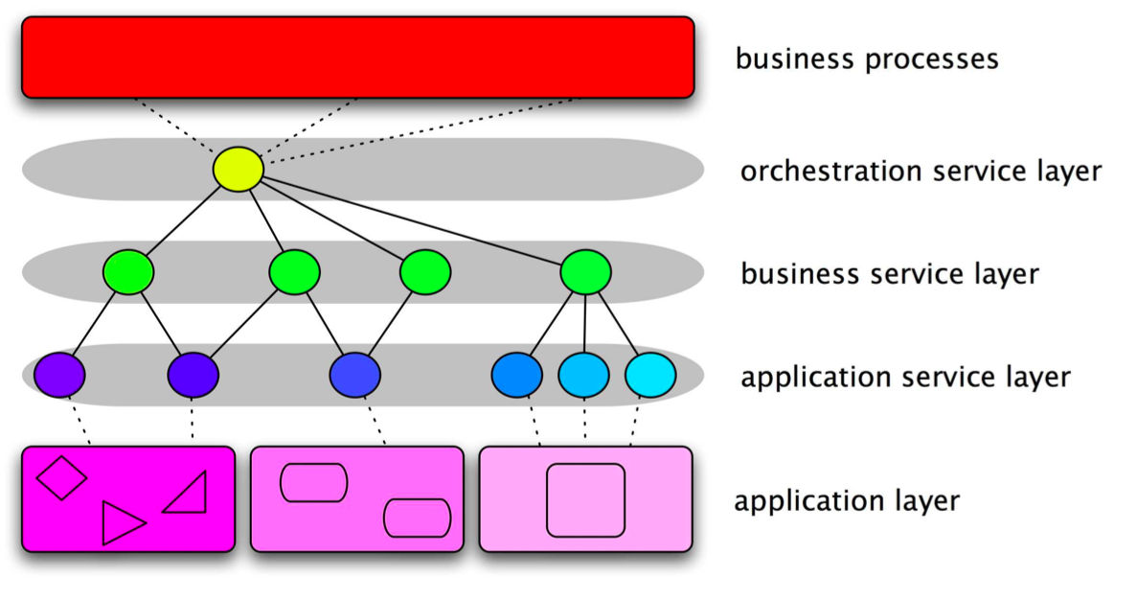
Traditional SOA = Layered Architecture

Slide 26






End-to-End Architecture and Functional Requirements for a Connected Business
Develop
Publish
Consume and Run
Secure
Monitor and
Manage
Systems
Of Engmnt
Web App
Development
Public / Private
App Store
Mobile Apps
Web Apps
Portal
SSO
Device Management
Web Access Mgt
API
SDKs
API Store
API Gateway
API Analytics
MBaaS
OAuth2
Service Tooling
Governance Registry
Enterprise API Gateway
Service
Access Control
Business
Analytics Monitor
SOA
Orchestration
Workflow
RT Stream Proc
ESB
Data
Virt
Taxonomy
Ontology
Data Tooling
Data Registry and Governance
Data Services
Data Access Control
Data Analytics
Big Data
Enterprise Cache
Adapter Layer
System
Of Record
Legacy Tooling
Traditional Documentation
SAP
MF
P’Soft
Legacy
Directory
Enterprise
Monitoring
Oracle
CICS
IBM
CRM

Slide 27
Micro and Macro Services “Segmented Architecture”
API Facade
API Facade
API Facade

Slide 28
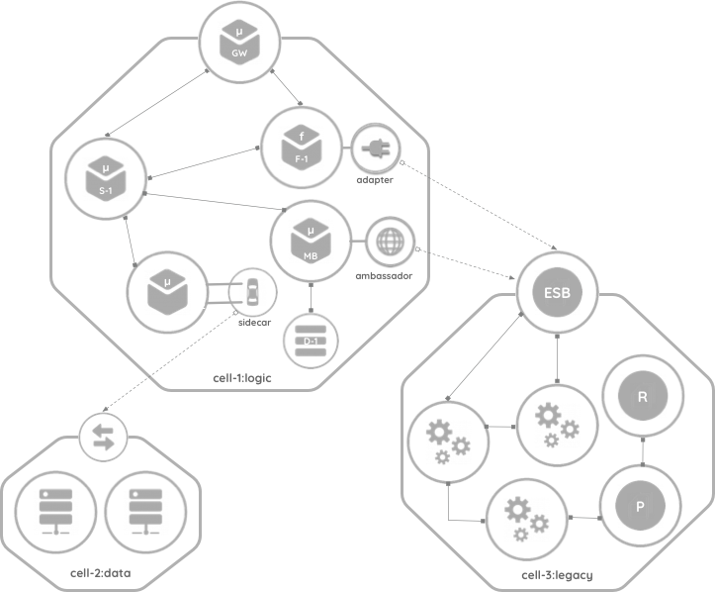
Cell Based Architecture
https://github.com/wso2/reference-architecture/blob/master/reference-architecture-cell-based.md

Slide 29
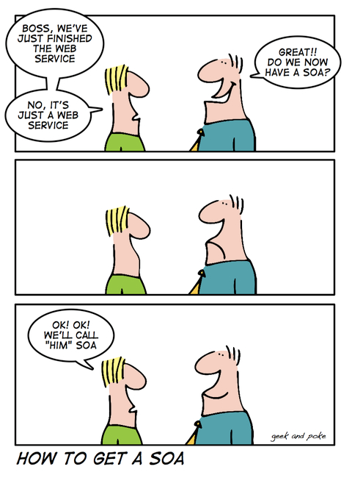

Slide 30
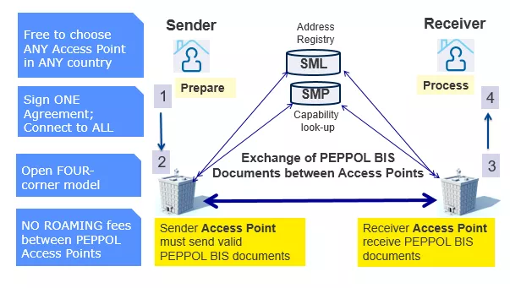
PEPPOL

Slide 31
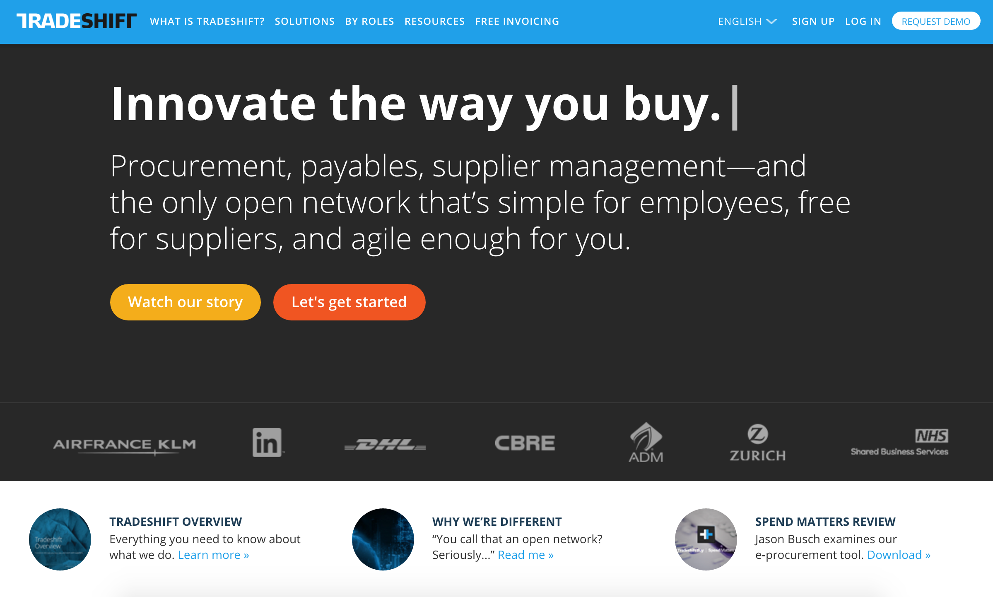
June 2016: Tradeshift raise $75m May 2018: Tradeshift raise $250m
Jan 2020: another $240m

Slide 32
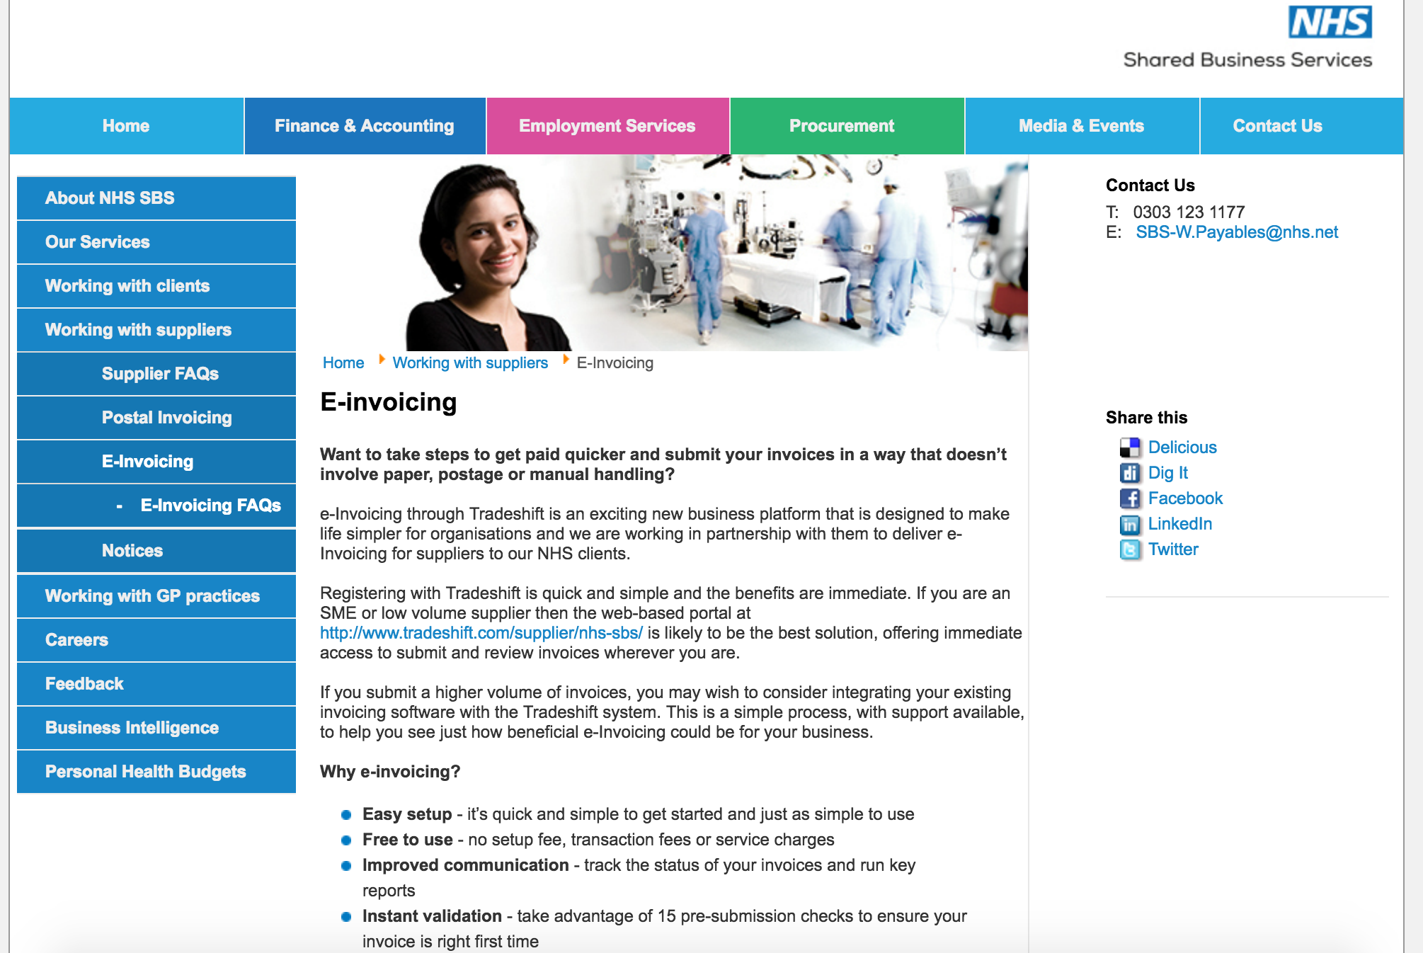

Slide 33
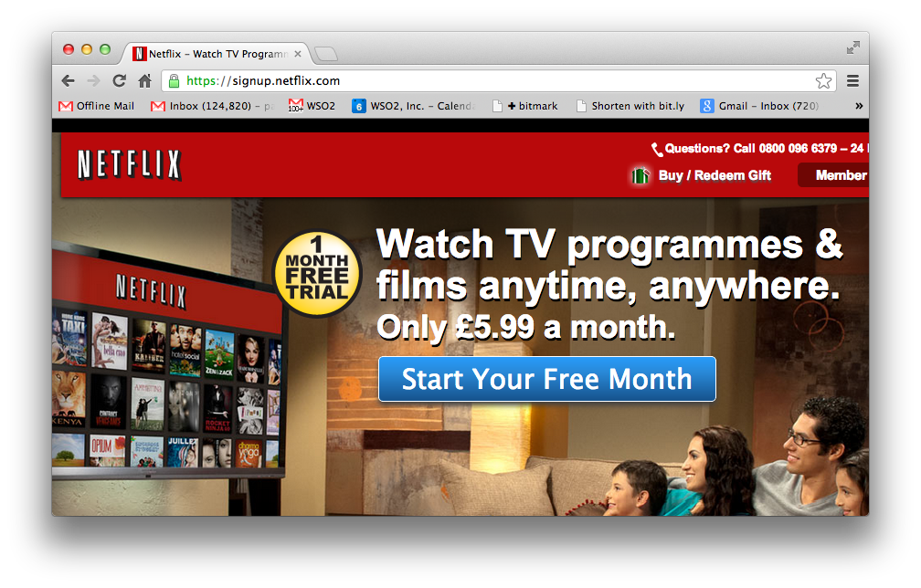

Slide 34
Netflix
A REST and Cloud based SOA approach
Continuous Delivery
100% Based in the cloud
See excellent presentations from Adrian Cockcroft
e.g. http://www.slideshare.net/adrianco/global-netflix-platform

Slide 35
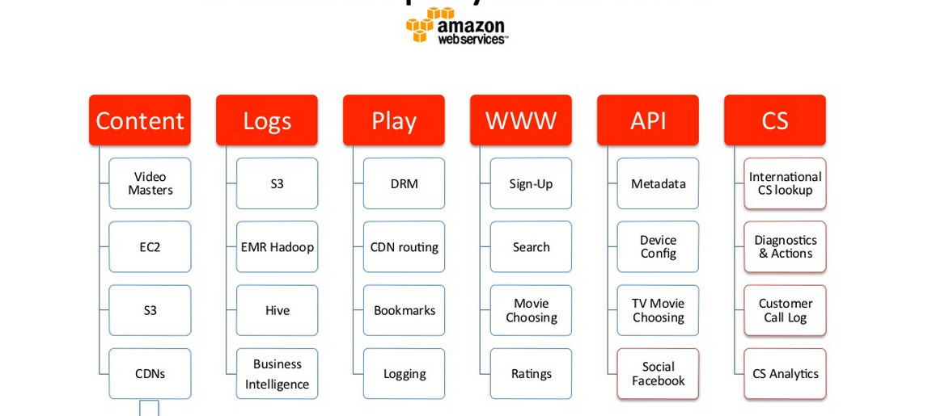
Netflix Deployed on AWS

Slide 36
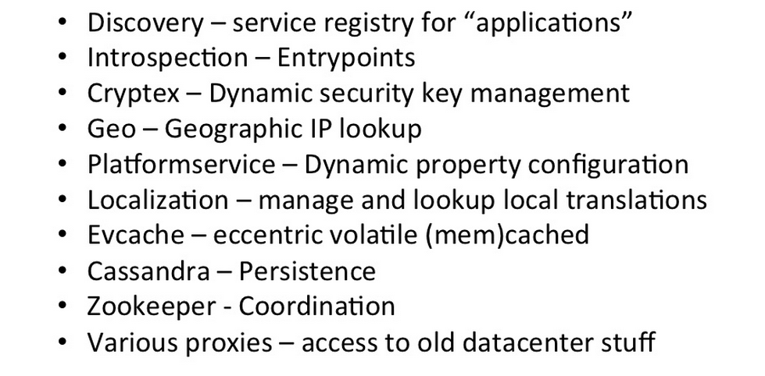
Platform Services

Slide 37
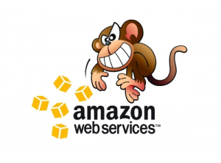
The (in)famous Chaos Monkey
Randomly kills machines
Yes, production systems
Proves that the system is resilient

Slide 38
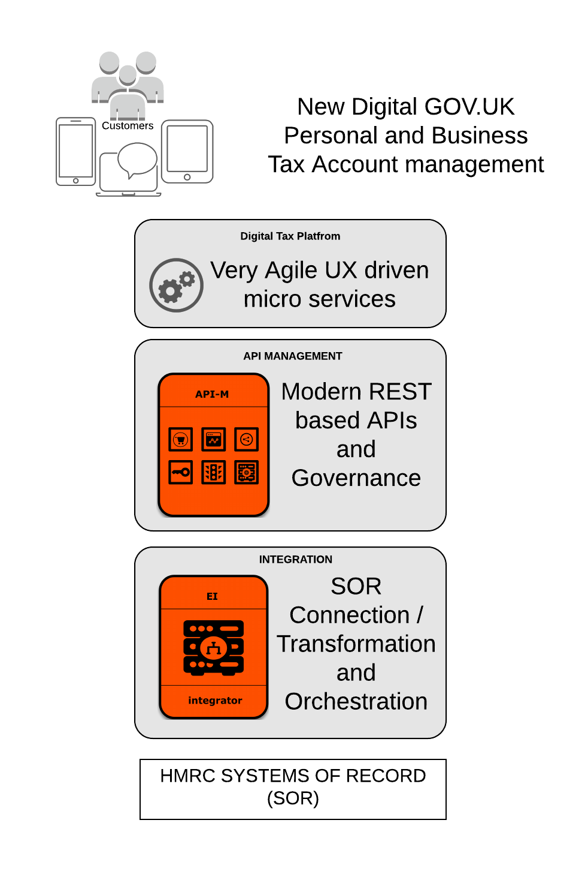
Use Case
Businesses and individuals make tax returns online without having to use older technology and paper-based alternatives.
Via Managed APIs, online Tax Applications get access to functionality of HMRC land 3rd Party Services on the Tax Platform
Tax Legacy Systems that maintain all tax related information of taxpayers & perform tax processing

Slide 39

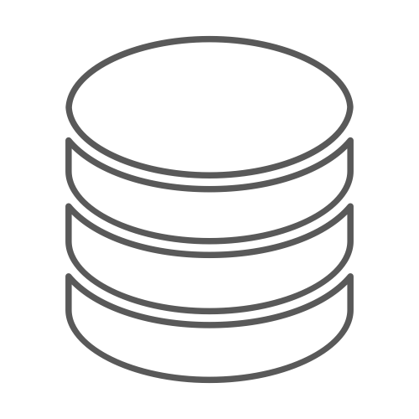





Solution Architecture
Data sources
Tax Legacy Systems
& Services
Notes:
https://docs.google.com/document/d/16SotNC-0XUMDxN-DRNgrIp_Kky7inMLqICzYsS6qudw/edit#
Need to draw diagram based on https://drive.google.com/file/d/0B5ZJY-Ns1gvkY3NIMEpiUE9fVjF0R01fczhJZE5uaHZ4WHhz/view

Slide 40
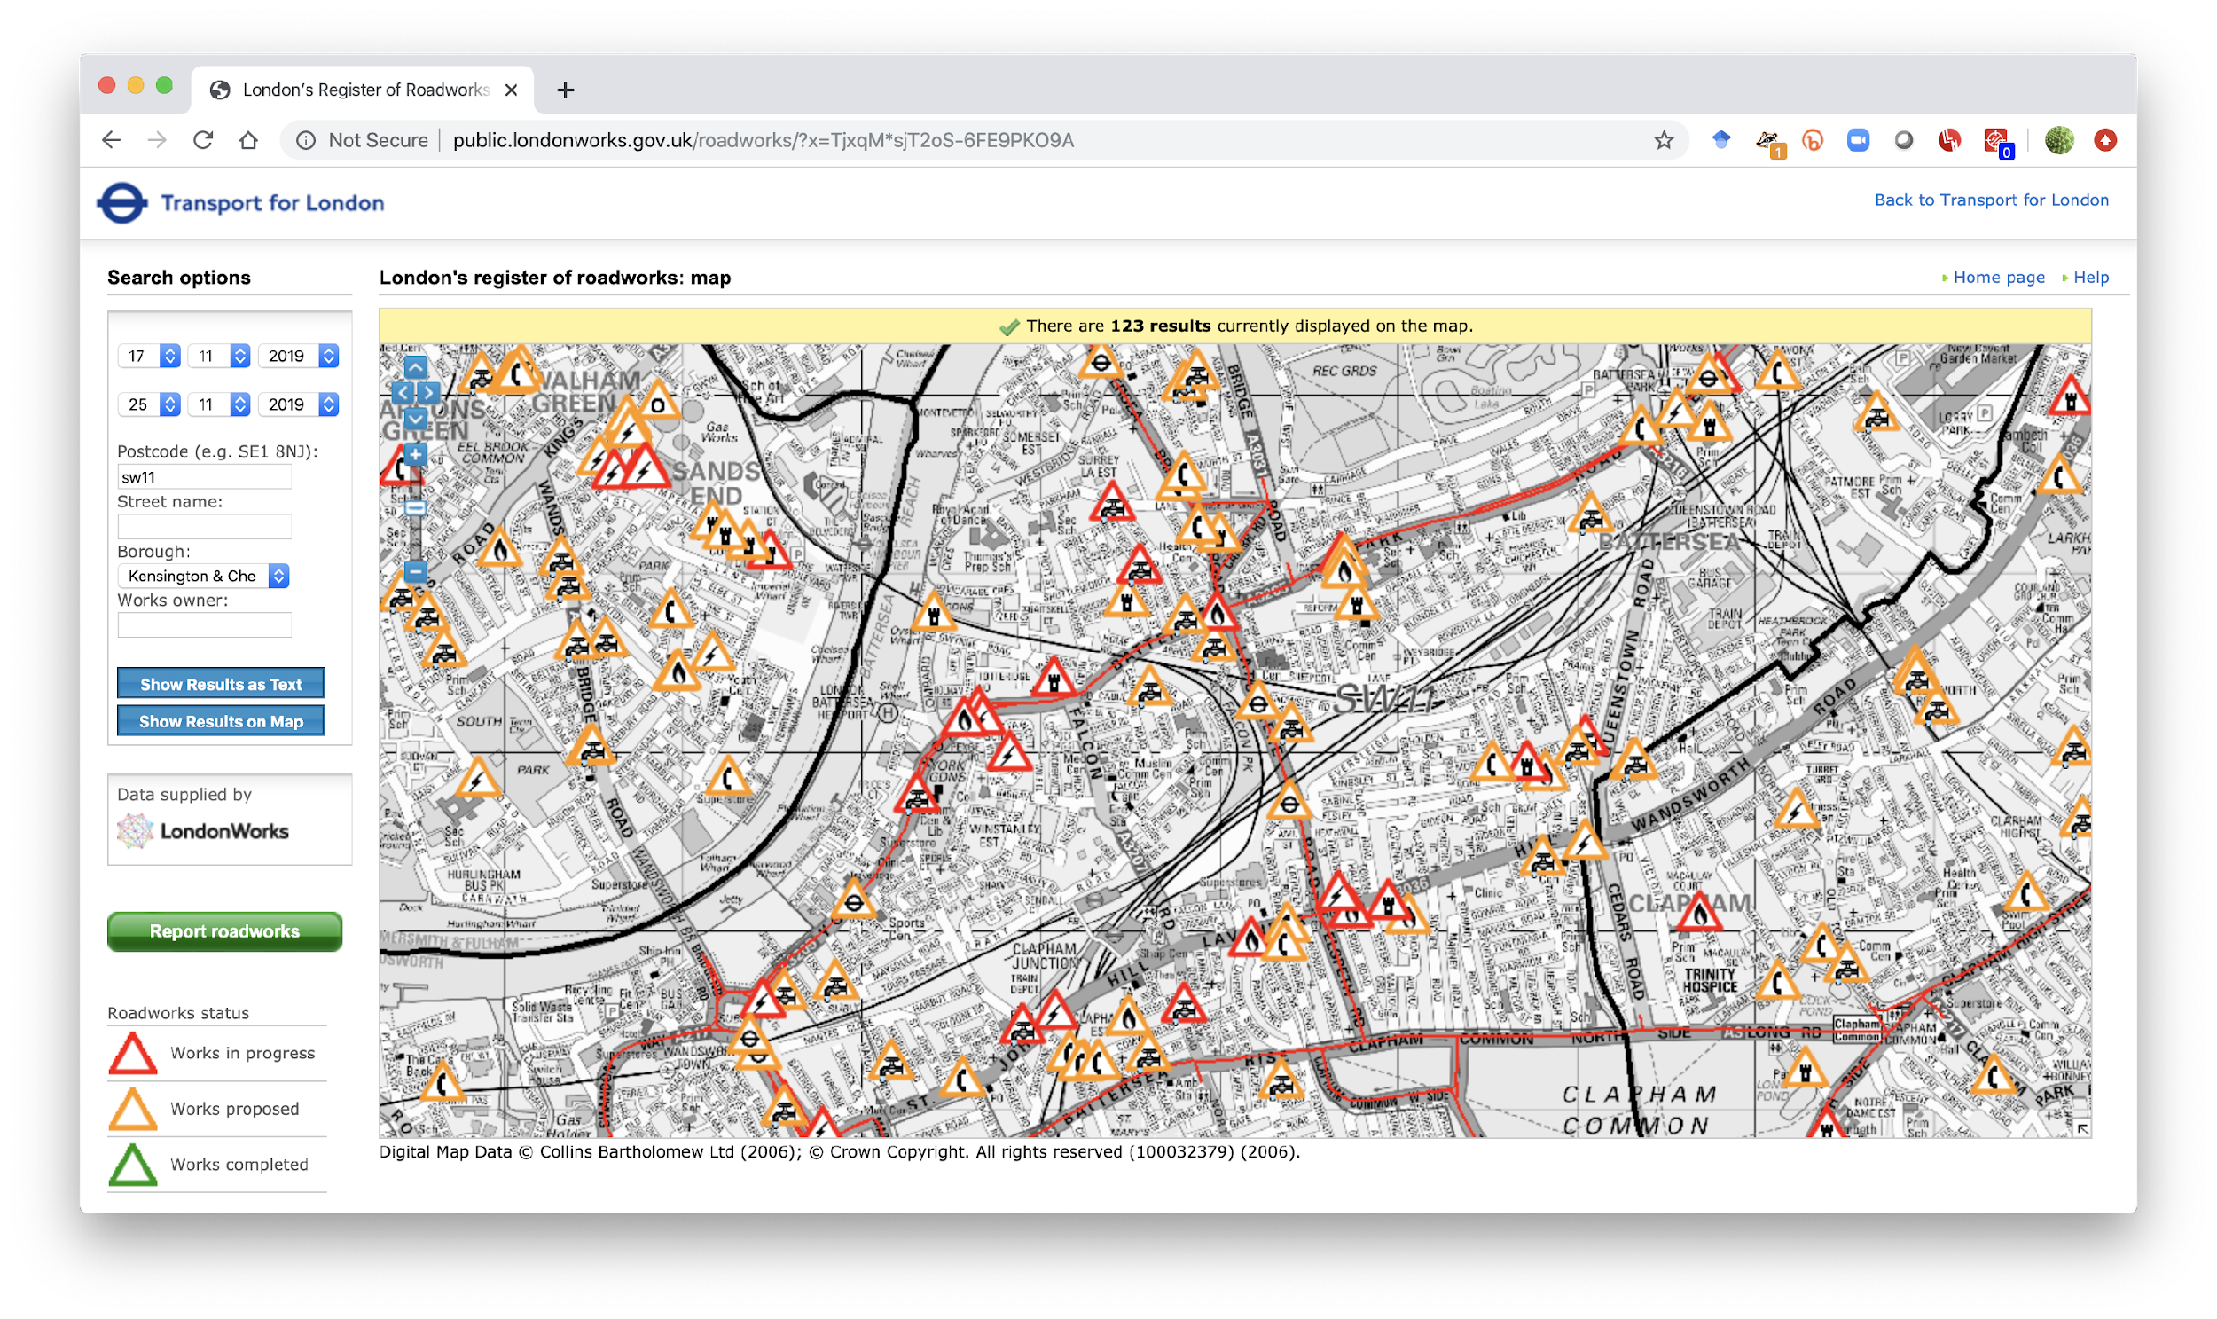

Slide 41
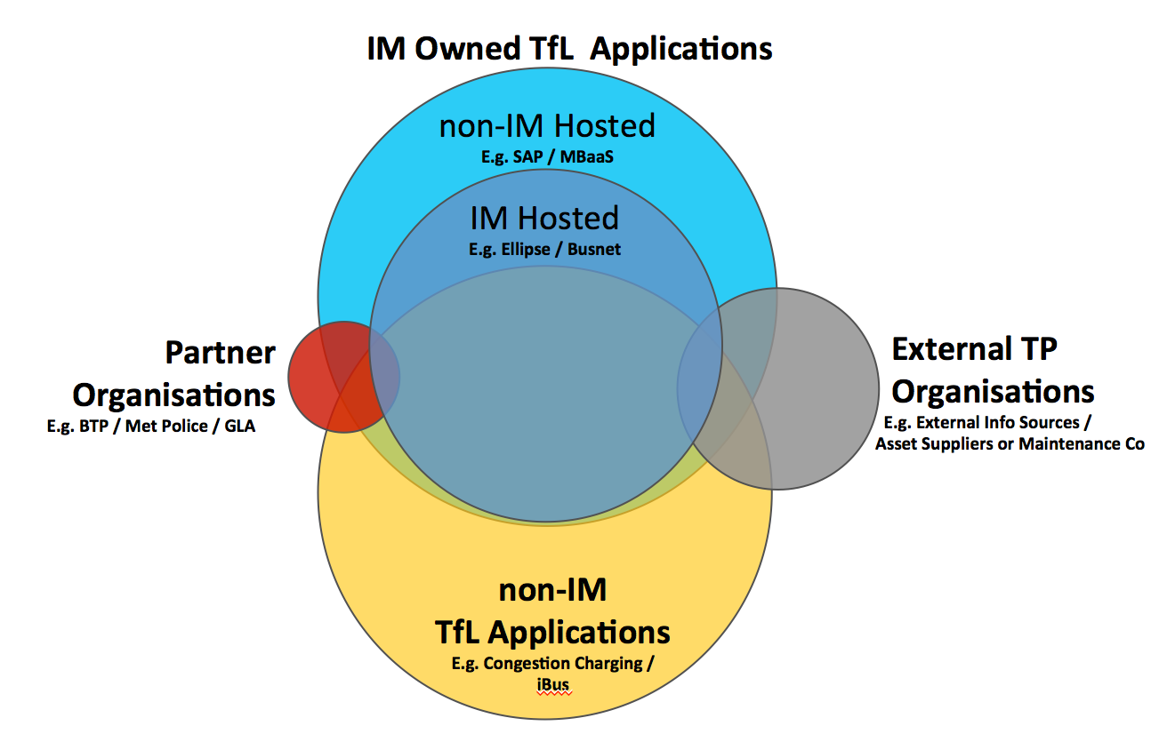
LondonWorks
TfL (Transport for London) is a Transportation Service Provider over 150 years.
Around 31 million journeys are made across the TfL network everyday.
TfL Integration Service is a service provided by IM (Information Management) department of TfL, which connects both IM and non-IM assets, and external organisations to provide/consume services to/from TfL.
LondonWorks is a collection of applications used to manage the planning, programming, and delivery of street works on London’s road network. It is the definitive source of road and street works information throughout TfL.
Notes:
TfL
Manages London's buses, the Tube network, Docklands Light Railway, London Overground, TfL Rail, and London Trams.
Run Santander Cycles, London River Services, London Dial-a-Ride, Victoria Coach Station, the Emirates Air Line, and London Transport Museum.
Regulates London's taxis, private hire vehicles, the Congestion Charge, and Low Emission Zone schemes
Information Management (IM) is the main department within TfL that is responsible for supporting a wide range of IT assets and communication technology.
TfL Integration Service is a service provided by IM such that it connects both IM and non-IM assets as well for some external organisations, such that they can provide or consume services to/from TfL.

Slide 42
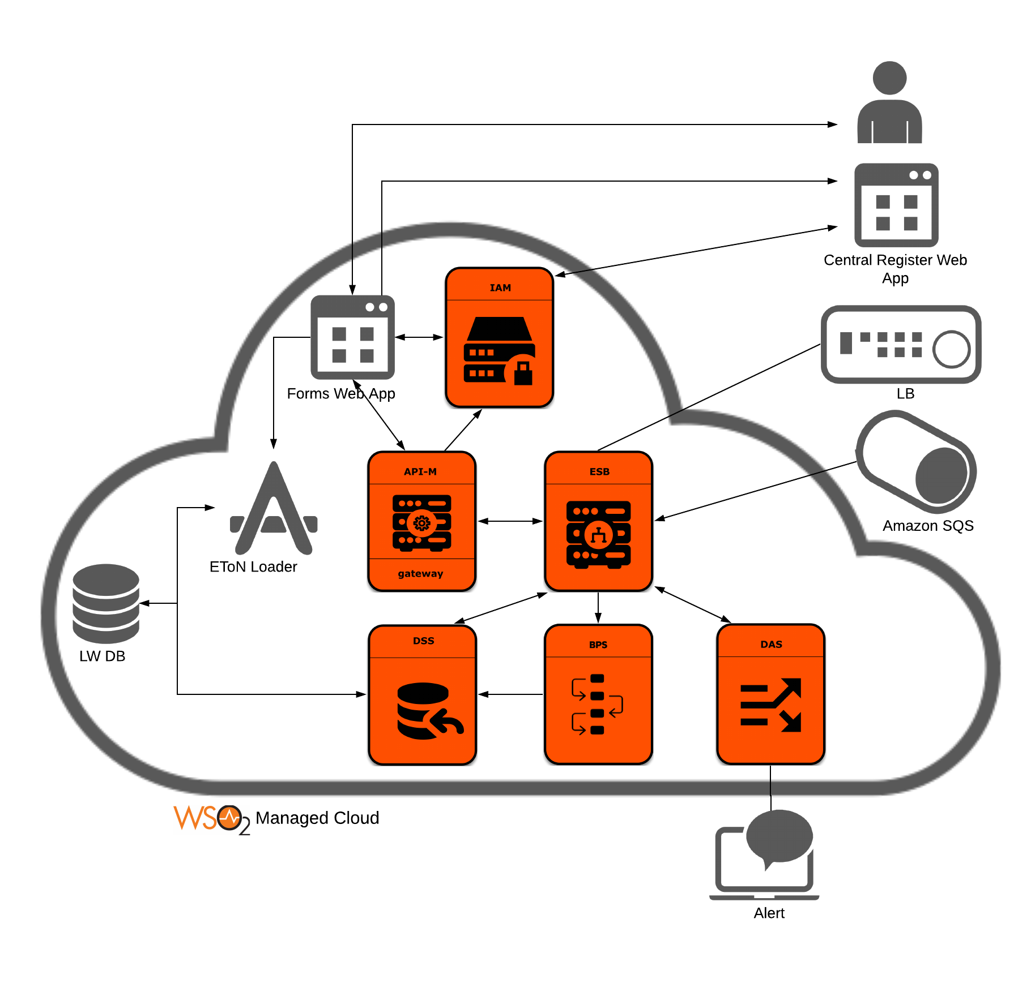
LondonWorks Architecture
Identity Service - Unified identity across TfL network
Integration Service - TfL Integration Service between databases, and various other applications
API Manager - API management for externally exposed APIs
Analytics - Event filters and alerts management
Business Process - management on TfL Integration Service
Notes:
The Identity Provisioning functionality helps maintain a unified identity across the TfL landscape. The WSO2 Identity Server is used to provide the system with SSO capability extending across the WSO2 portal, the Esri GIS user interfaces and also the rest of the TfL web-based infrastructure that is being used in the context of this project.
The EToN loader application provides processing of incoming notifications which will subsequently be stored into a database. The data will then be forwarded to the GIS service via an ETL process that extracts the information that is relevant for the end-user facing interfaces.
The Web Forms application(s) that are hosted on the portal provides end users with an expansive user interfaces that also combines maps from ArcGIS online and workflows running within the TfL Integration Service. The JS-based integration combined with the OAuth-based SSO provides the end user with a seamless experience.
The TfL Integration Service (WSO2 Middleware) provides integration capability between the databases, the various applications, and also the ArcGIS Web Adapter. The Enterprise Service Bus, Data Services Server, Data Analytics Server and the Data Services Server from WSO2 is being used for this purpose.
The WSO2 Enterprise Service Bus and ArcGIS uses Amazon SQS to pass filtered events between them in the process of generating alerts.
The WSO2 API Gateway provides management of the APIs exposed by the TfL Integration Service to third parties.
Reference https://docs.google.com/document/d/17uh6doiFSXXcIzDy3OQ1qtxjQVmy3SmTwa2jUDHZ_Bs/edit#

Slide 43
Twitter Architecture
Open Sourced their technology:
Finagle
http://twitter.github.io/finagle/
Called an RPC system, but completely asynchronous
Based on “Services”

Slide 44
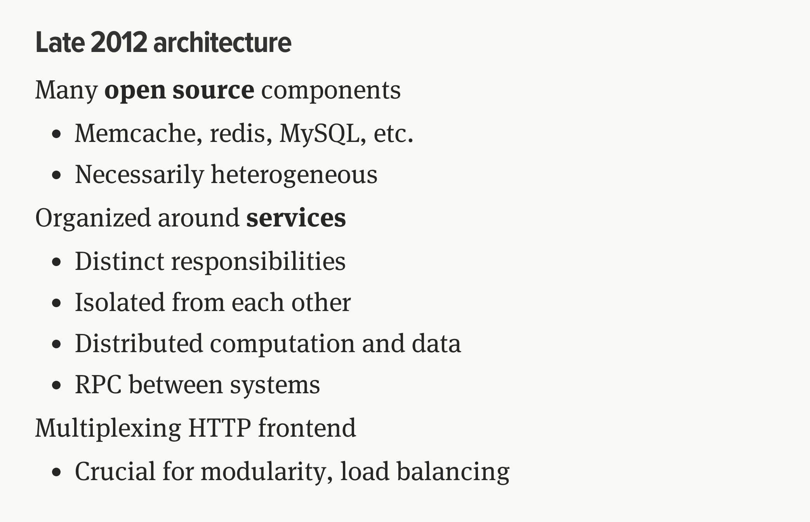
http://monkey.org/~marius/talks/twittersystems/#4

Slide 45

Boeing Digital Airline

Slide 46
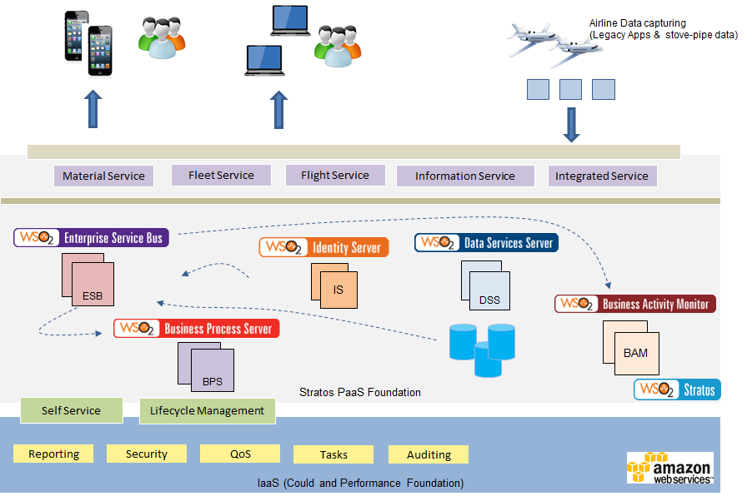
Case Study : Boeing - A PaaS based Integration and API ecosystem
Notes:
Keywords Cloud, API Integration, Billing and Monetization, Governance
Solution Targets to cater for 13,000 Boeing airplanes in Service at 900 airlines
A solution that can scale for 90 million transactions per month (as an end state)
PaaS solution to integrate airlines and OEM data
Reusable app services
Open architecture and modular design

Slide 47
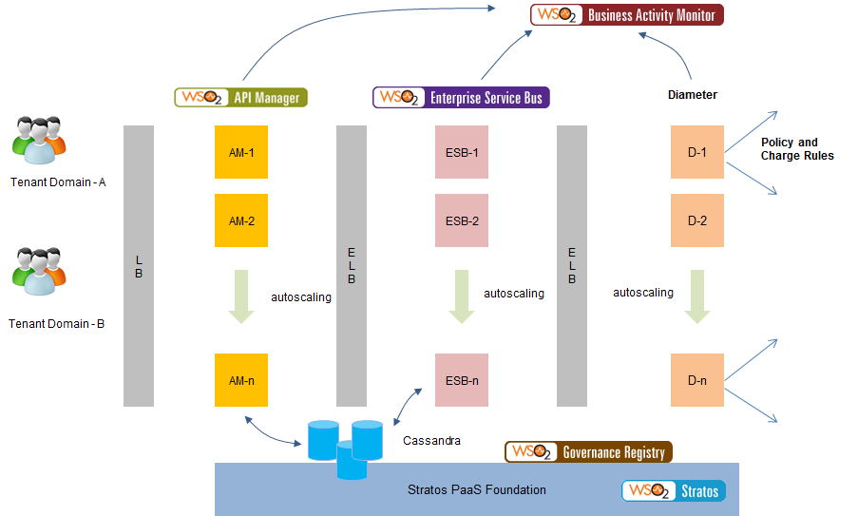
Case Study : Multi-tenanted Mobile Orchestration Gateway Platform
Notes:
Keywords Cloud, API Management, Statistics and Monetization, Openstack
Solution 40,000 transactions per second
Support for 99.999% service availability
Support for autoscalling based on Stratos2 implemented on top of Openstack
Tenant based access control for enterprises.
Unified enterprise onboarding
Licensing integration, statistics and monertization

Slide 48
Pay TV company
Needed to scale up to provide instant pay-as-you-go on mobile devices
Support Disaster Recovery (DR)
Elastic Scale e.g. during an important football match

Slide 49
Architecture
Clients
Clients
Clients
Existing architecture
(no changes)
RESTful Services
Notification
Integration Layer
Replication
Cloud/NoSQL Multi-Master Database
Cloud Platform
Cloud Datacenter

Slide 50
Anti-patterns
Use a full waterfall model
Don’t budget time for integration test
Assume that standard coding unit test->integration test will work
Build unit tests that don’t test interoperability
E.g. Simulate XML request/response inside the calling system rather than calling a remote system
Wait until all the systems are ready before starting any integration test
A delay to one system will hold up testing all the others
Don’t bother with continuous build and test
Even better build by hand
Even better test by hand too
Have a nice complex process to hand over from development to test
That way each defect will take a long time
Wait until the project is failing to find out your team doesn’t have the skills

Slide 51
Questions?

